Slide 1

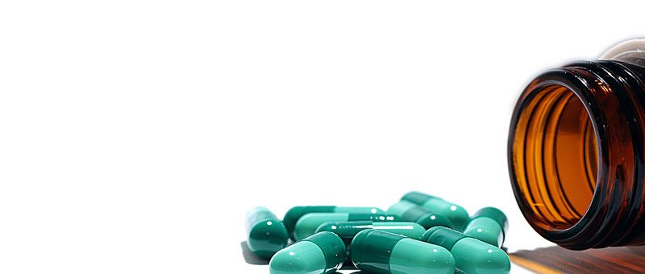
Medication Review Market Analysis for Osteoporosis

Slide 2

Background. A Client Launched a New Medication
2017 – FDA approves the new medication to treat postmenopausal osteoporosis in the US
2021 – FDA approves the removal of some warnings of the new medication
Research Needs:
Which drugs are leading the market?
Who are the target demographics?
What are the market drivers?
What are the opportunities?
2

Slide 3
Approach and Methodology
Which drugs are leading the market?
Analyze current market data to identify the most prescribed drugs to treat osteoporosis.
Who are the target demographics?
Analyze current market data to identify the demographics of the users.
I
Data Analytics
What are the market drivers?
Analyze the medication reviews to identify what certain drivers lead to positive reviews.
What are the opportunities?
Analyze the medication reviews to understand what the patients are looking for from their medications.
II
Language Model

Slide 4



About the Data
Dataset
12 Features
Data Preprocessing
WebMD Drug Reviews
Context:
The dataset provides user reviews on specific prescription drugs along with conditions, side effects, age, sex, and user rating reflecting overall patient satisfaction.
Source: https://www.kaggle.com/datasets/rohanharode07/webmd-drug-reviews-dataset.
Size: 362,806 x 12
Drug (categorical): name of drug
DrugID (numerical): drug id
Condition (categorical): name of condition
Review (text): patient review
Side (text): side effects associated with drug (if any)
EaseofUse (numerical): 5 star rating
Effectiveness (numerical): 5 star rating
Satisfaction (numerical): 5 star rating
Date (date): date of review entry
UsefulCount (numerical): number of users who found review useful
Age (numerical): age group range of user
Sex (categorical): gender of use
Restrict condition to osteoporosis
Remove duplicate reviews
Re-code the age to the desired buckets
4

Slide 5
Overview of Osteoporosis-related Illnesses
Conditions | Number of Reviews
Osteoporosis Osteoporosis in Male Patients Aromatase Inhibitor Drug-Induced Osteoporosis Osteoporosis in Men due to Deficient Function of Testis Post-Menopausal Osteoporosis Prevention Osteoporosis in postmenopausal woman at high risk for fracture Osteoporosis caused by Glucocorticoid Drugs Glucocorticoid-Induced Osteoporosis Prevention Osteoporosis caused by Anti-Androgen Drugs | Female: 1116 Male: 71 Unspecified: 170 Number of Unique Drugs: 71 Rating Records from 2007 to 2020
5

Slide 6
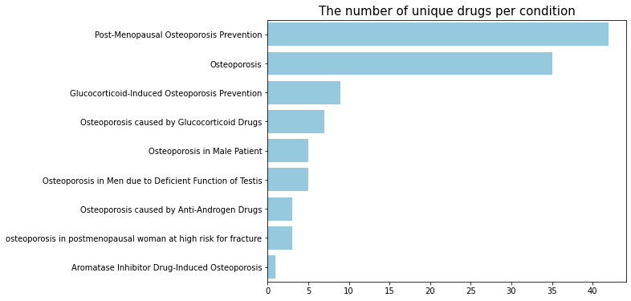
Most Treated Conditions
Post-Menopausal Osteoporosis Prevention and Osteoporosis had the most number of unique treatments.
TYMLOS treats Post-Menopausal Osteoporosis.
6

Slide 7
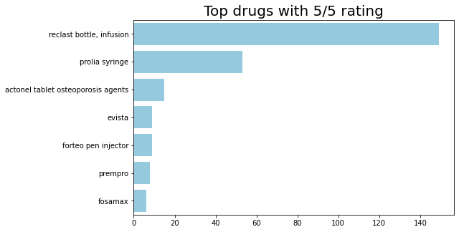
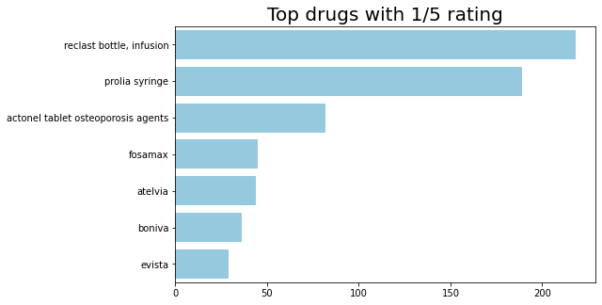
Best and Worst Drugs Based on Ratings
Observation:
Reclast Bottle, Prolia, and Actonel Tablet are top 3 for BOTH the best and the worst rated drugs.
7
Difficult to identify the market leaders based on ratings

Slide 8
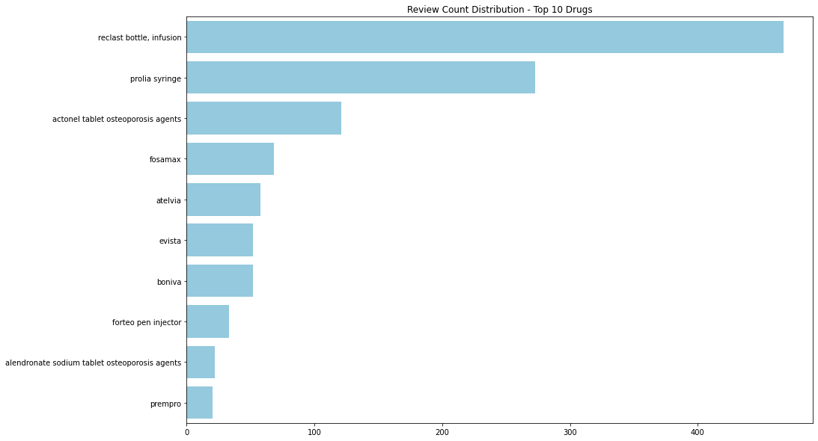
Top Medications Based on Number of Reviews
Assumption:
Amount prescribed is proportional to the amount reviewed.
8
Reclast Bottle (non-injectable) and Prolia (injectable) stand out as the most reviewed drugs.

Slide 9
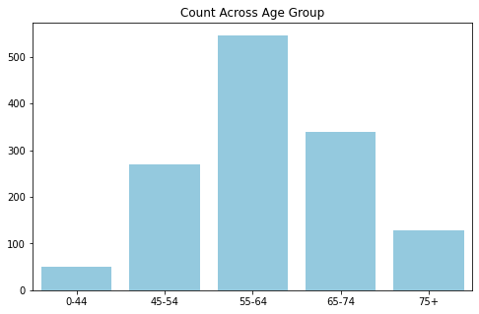
Target Demographics
Statistics:
82% of the patients are women.
Observation:
A large majority of the patients are from ages 45-74.
Conclusion:
Women in the ages 45-74 is the target demographics.
9

Slide 10
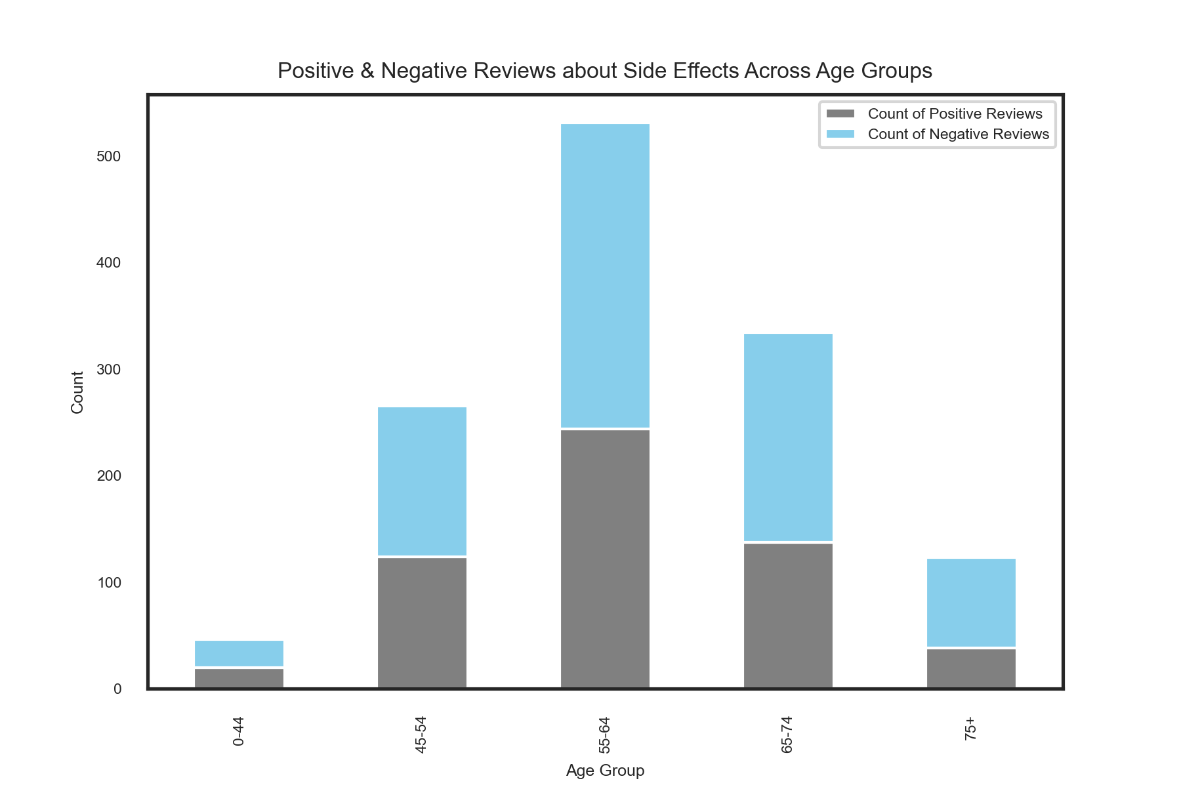
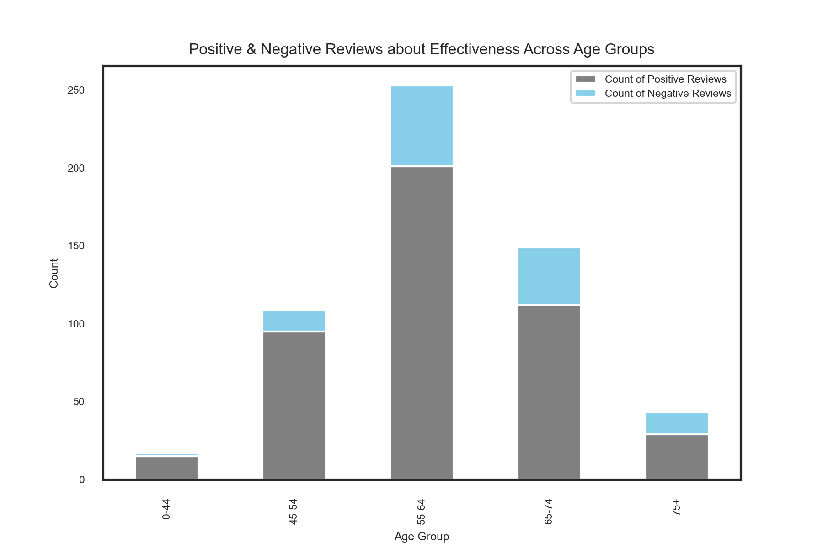
Reviews about Effectiveness/Side Effects
Observation:
Observation:
Almost all reviews were related to side effects.
Majority of the reviews related to effectiveness were positive
10
Notes:
People leave a review if the drug is effective, and if side effects exists.

Slide 11
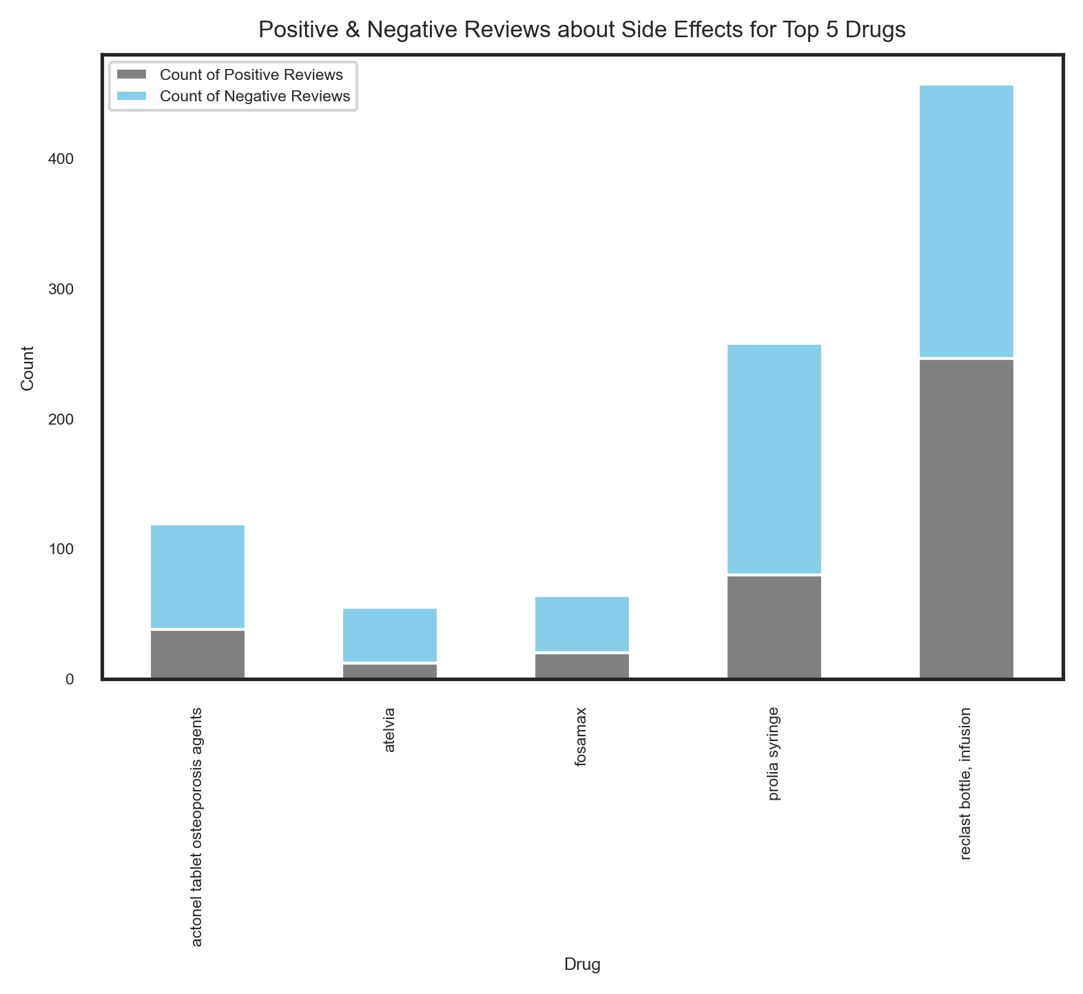
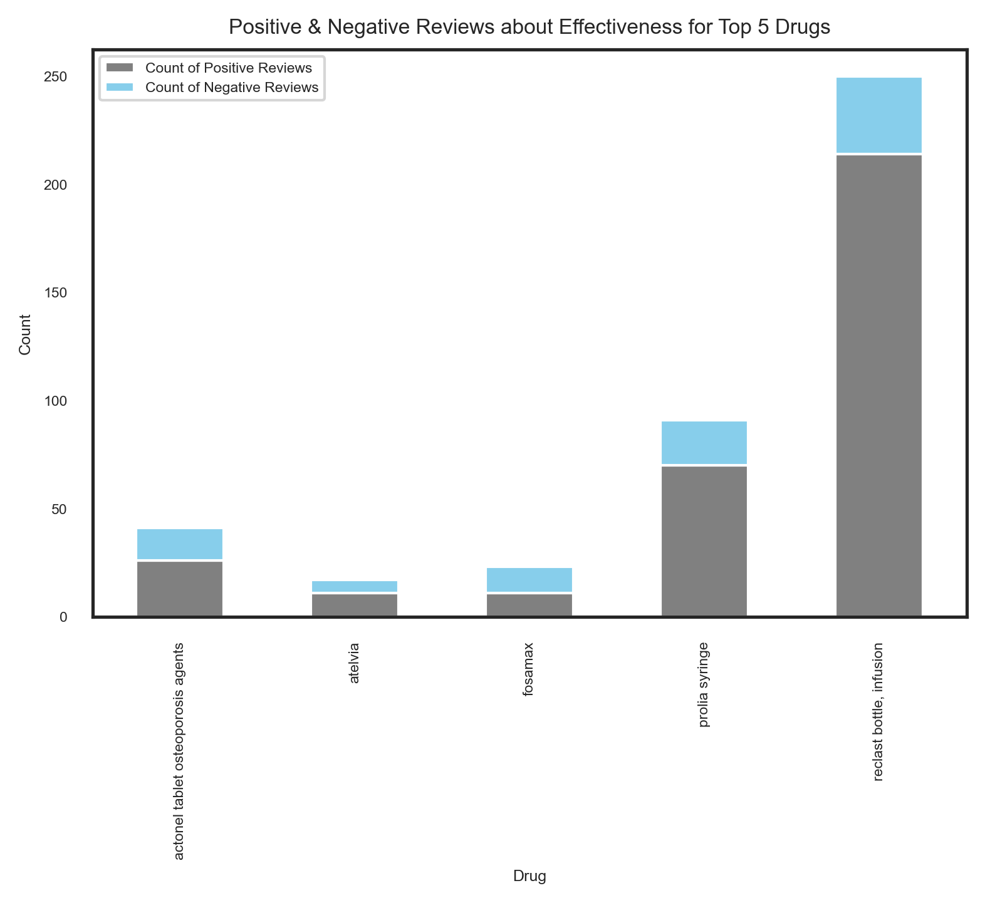
Positive & Negative Reviews about Effectiveness and Side Effects for Top5 Drugs
11
Reclast bottle, infusion is the most effective medication, but also has serious side effects

Slide 12
Summary Insights
Which drugs are leading the market?
Reclast bottle, Prolia, Actonel Tablet, Fosamax, and Atelvia were the top 5 drugs to treat osteoporosis.
Who are the target demographics?
Women between the ages of 45-74
I
Data Analytics
What are the market drivers?
Most reviews are related to side effects.
The majority of the reviews related to effectiveness were positive.
The majority of the reviews related to the side effects were negative.
What are the opportunities?
Top 5 drugs have concerning side effects according to the user reviews.
II
Language Model

Slide 13

Way Forward:
Language models to determine specific side-effects and their distribution among the different age groups.
Use of predictive modeling to obtain more fine-grained product-specific information.
(Are injectables more favorable than non-injectables?).
Further explore the relationship between market share and aggregate
the quality of review for top osteoporosis medications.

Slide 14

Appendix

Slide 15
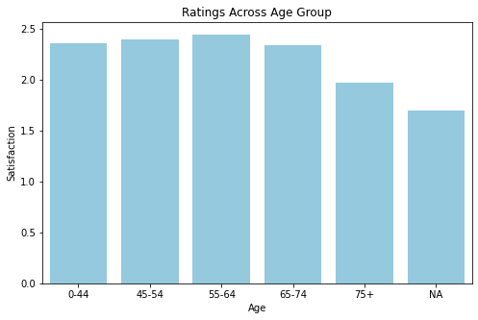
Frequency and Review Scores of Age Demographics.
Insights:
Frequency appears normally distributed over age, centered in the 55-64 age group while review scores are about uniformly distributed over age.

Slide 16
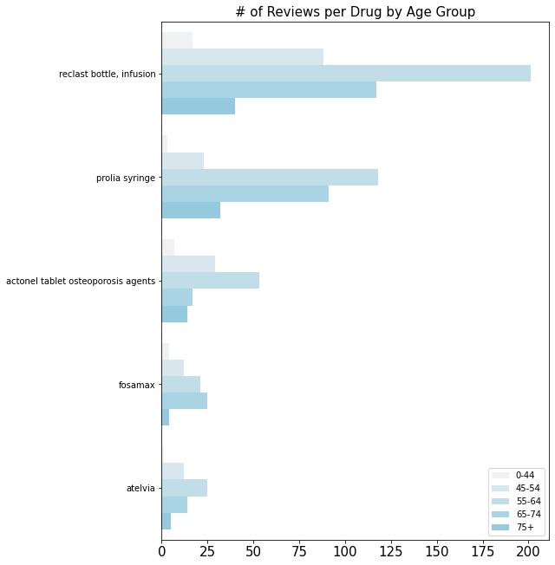
Frequency of Reviews for most Reviewed Medications.
Insights:
Frequency appears normally distributed over age, centered in the 55-64 age group while review scores are about uniformly distributed over age.

Slide 17
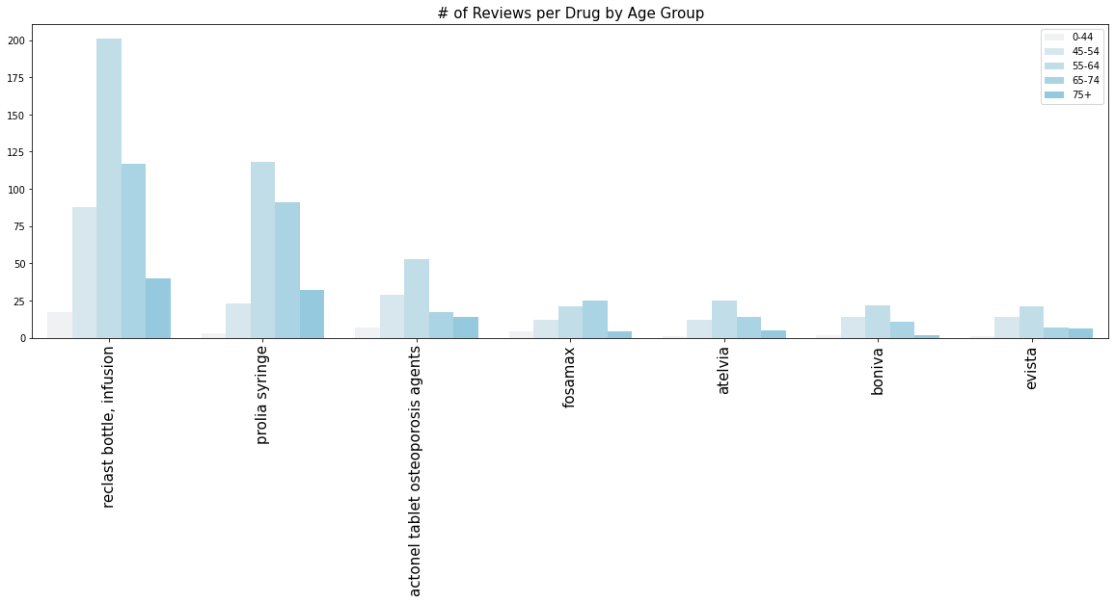
Frequency of Reviews by Age Group For Most Reviewed Medications
The age proportions remain constant across the most frequently reviewed drugs.
Notes:
One or two sentences, distinct color

Slide 18
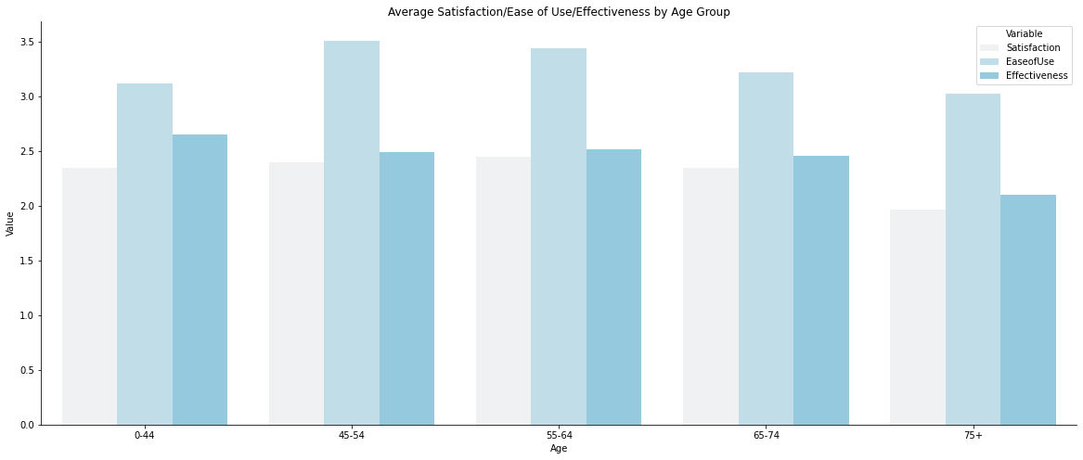
Average Ratings for Satisfaction, Ease of Use, and Effectiveness Across Age.
Insights:
There does not appear to be a major relationship between age and these three features.
Bullet 2

Slide 19
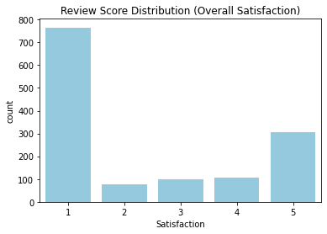
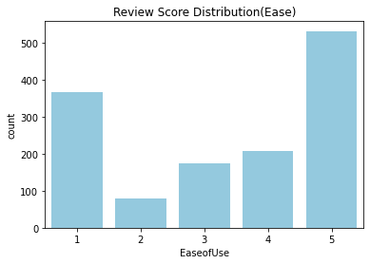
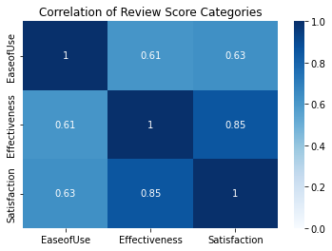
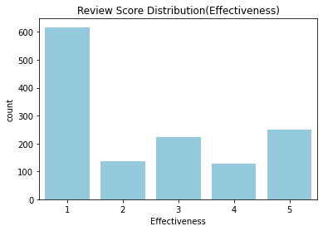
What is generally driving satisfaction? Ease of use or effectiveness?
1. Satisfaction is highly correlated with effectiveness. Moderately with ease of use.
2. Reviews tend to have higher ease of use ratings and lower satisfaction ratings.

Slide 20
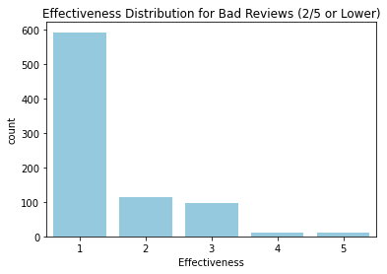
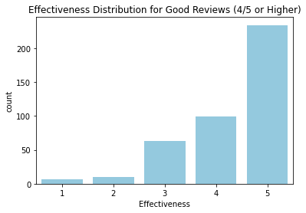
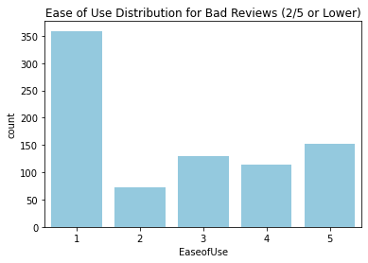
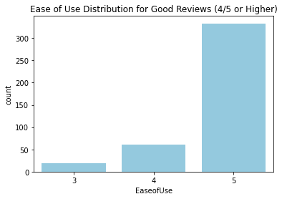
Good Reviews and Bad Reviews: What can we understand from the sub-categories?
1. Low effectiveness = Low satisfaction
2. Low ease of use = Low satisfaction
3. High effectiveness = High satisfaction
4. High ease of use ~ High Satisfaction (Weaker relationship)

Slide 21
Average Ratings for Non-injectable vs. Injectable Treatment: targeted at different age groups
Drug Name | Type | Count
Prolia Syringe Reclast bottle, infusion Zometa vial Atelvia Actonel tablet osteoporosis agents | Injectable Injectable Injectable Non-injectable Non-injectable | 545 148
Notes:
Split up info, direct attention

